Slide 1
The PIC microcontroller
PIC18F4520: Introduction, Architecture

Slide 2
Embedded System
A system whose principal function is
not computational
but which is
controlled by an embedded computer

Slide 3
Microprocessors vs Microcontrollers
Microprocessor: processor on one silicon chip.
Microcontroller: microprocessor with added circuitry
Thus microprocessor is a sub-set of microcontroller
Intel Microprocessor vs PIC Microcontroller
Intel is more complex, costs more, is more powerful
PIC is less costly, less complex, far less powerful
Paradox: How come Intel is a sub-set of PIC!

Slide 4
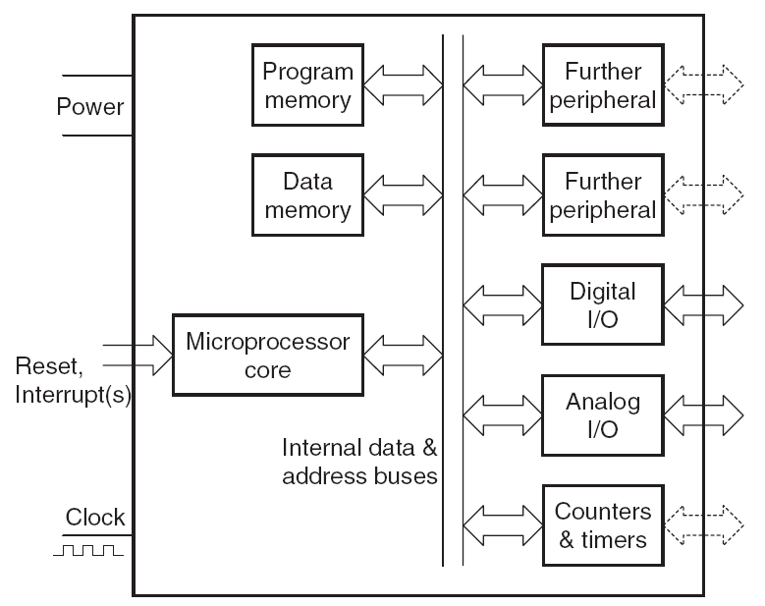
Microcontroller Internals

Slide 5
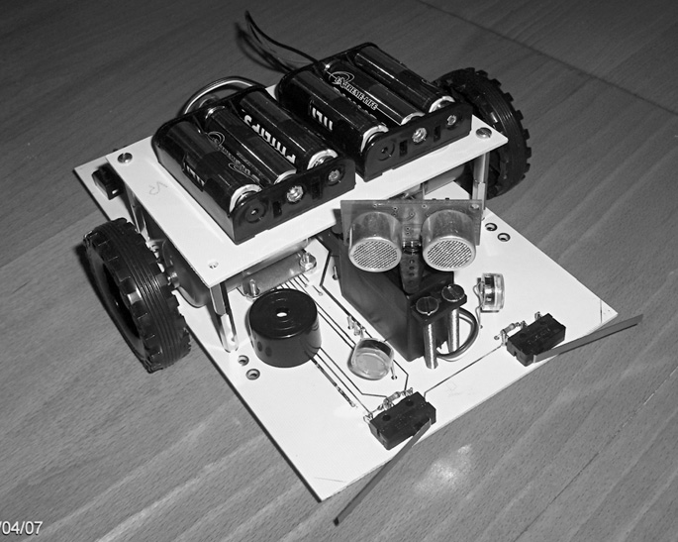
Example: Autonomous Guided Vehicle

Slide 6
Human Locomotion: Basics
Need for motion
Go from point A to point B
Sense the environment
Using “sensors” – eyes, ears, nose, skin
Chart possible paths
Assess risk, choose the best path
Actuate the “moving engine”
Start moving legs – in walking / running / creeping / crouching pose
Keep sensing the environment for “changes”
Respond to changes
Assess risk
Keep “moving”

Slide 7
Machine locomotion: Comparison
Human locomotion
Machine locomotion
Need for motion
Sense the environment
Chart possible paths
Actuate the “engine”
Keep sensing
Respond to changes
Need for motion
Robotic movement problem
Sense the environment
camera, sonar, lidar, radar
Chart possible paths
Path planning algorithms
Actuate the “engine”
“motors” – speed, direction
Keep sensing
Respond to changes - bump

Slide 8
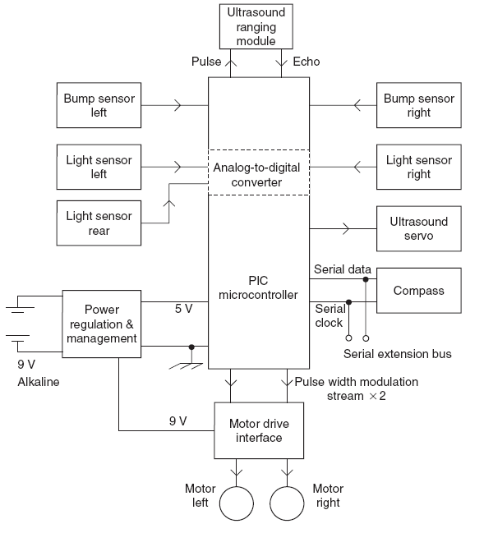
Autonomous Guided Vehicle: Internals

Slide 9
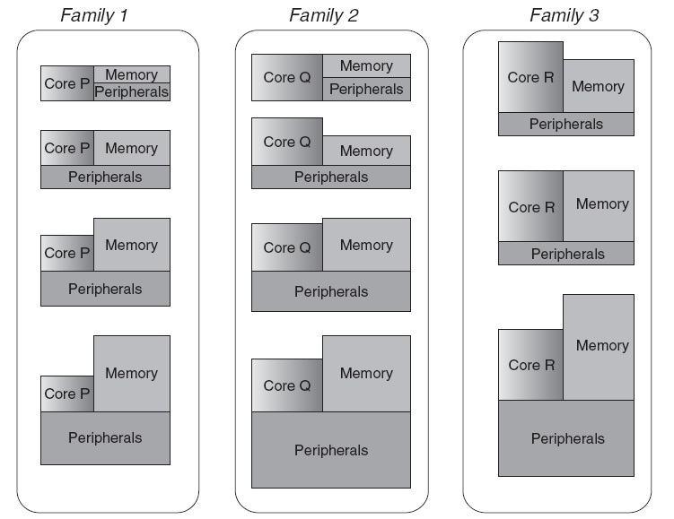
Microcontroller Family – the concept

Slide 10
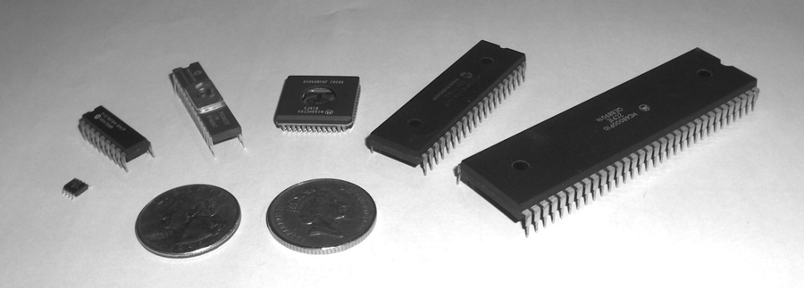
Microcontroller Packaging, Appearance
From left to right: PIC 12F508, PIC 16F84A, PIC 16C72, Motorola 68HC05B16, PIC 16F877, Motorola 68000

Slide 11
PIC Microcontrollers - history
Peripheral Interface Controller (PIC) was originally designed by General Instruments
In the late 1970s, GI introduced PIC1650 and PIC1655 – RISC with 30 instructions
PIC was sold to Microchip
Microchip today ends up making most of the 8-bit PICs
We are studying the PIC18F family controller
Features: low-cost, self-contained, 8-bit, Harvard structure, pipelined, RISC, single accumulator, with fixed reset and interrupt vectors

Slide 12
PIC Family: Development history
PIC Family | Stack Size | Instruction Word Size | No of Instructions | Interrupt Vectors
12CX/12FX | 2 | 12- or 14-bit | 33 | None
16C5X/16F5X | 2 | 12-bit | 33 | None
16CX/16FX | 8 | 14-bit | 35 | 1
17CX | 16 | 16-bit | 58 | 4
18CX/18FX | 32 | 16-bit | 75 | 2
‘C’ implies CMOS technology; Complementary Metal Oxide Semiconductor
‘F’ insert indicates incorporation of Flash memory technology

Slide 13
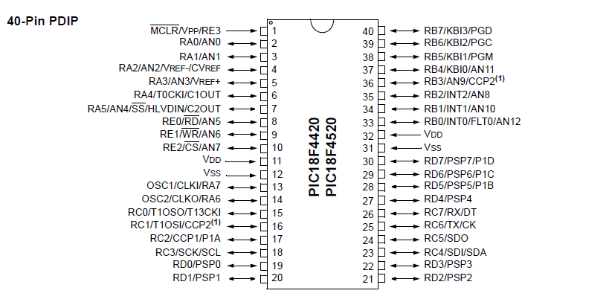
PIC18F4520: Pin-out

Slide 14
PIC18F4520: Pin-out observations
Almost all pins are “multi-functional”
A / B / C
eg. OSC1 / CLKI / RA7 (pin 13)
Lowers cost – by driving down “pin real-estate”
Assumption: You may not need all 2/3 functions on a pin at once
PIC is a soft-configured controller
Pin function is decided by software (code)
The only pins which are not multi-functional
V_{dd}, V_{ss}

Slide 15
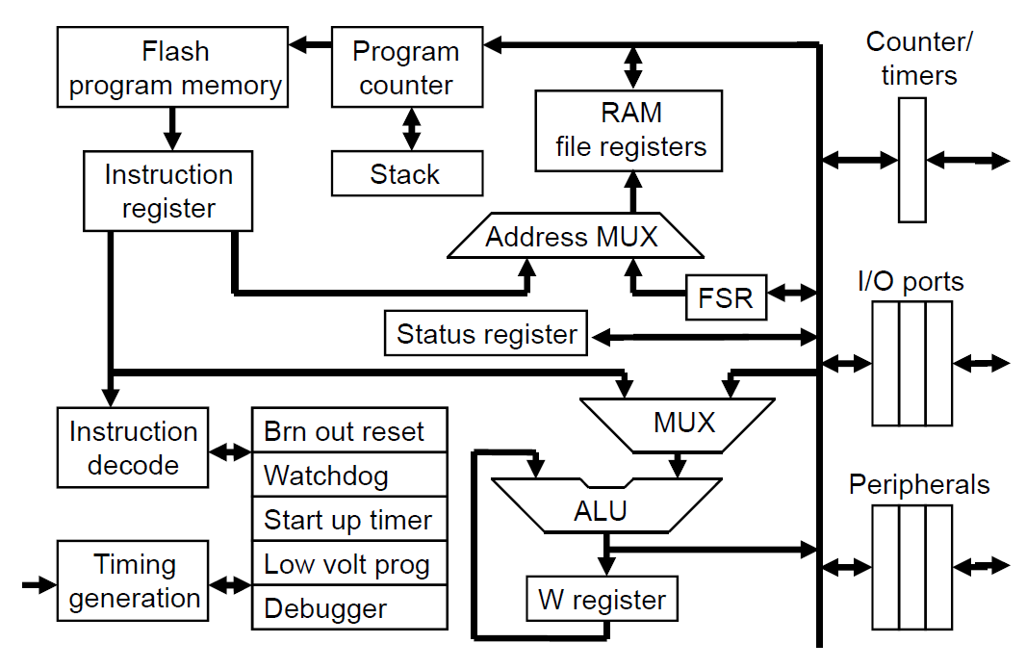
PIC18F: Controller Architecture

Slide 16
PIC: Program data flow
“Controller Bus”
“FREG”
“WREG”

Slide 17
What are PIC instructions like?
Type 1
Data comes along with the instruction
Example: ADDLW 0x20
Type 2 – unified address space
Data comes from file registers
Internal RAM
Example: ADDWF 0x20
External (real-world) peripheral
Example: ADDWF PORTA
Type 3
Data comes from “pointer” file-registers (FSRs)
Example: ADDWF INDF0

Slide 18
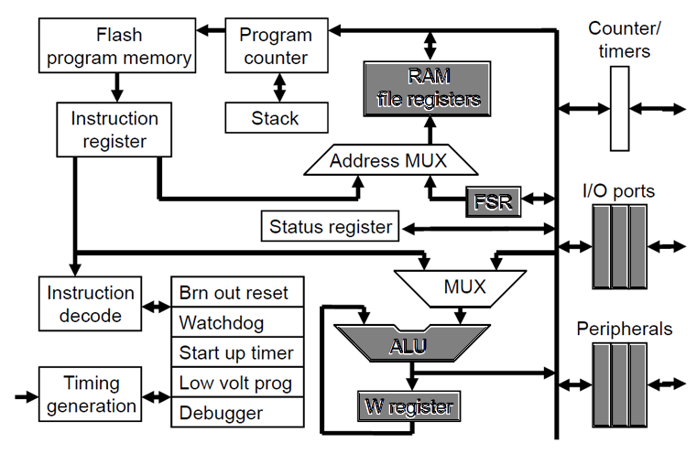
PIC18F ALU: It’s different!

Slide 19
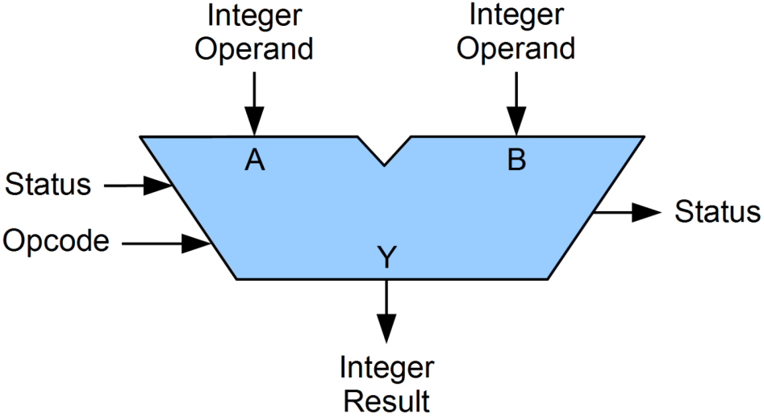
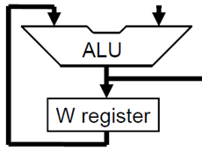
PIC18F: ALU – how different?
Regular ALU
Result = Input1 (Operation) Input2
PIC18F ALU
Result = [WREG] (Operation) Input2

Slide 20
PIC18F ALU: Details
Arithmetic and Logical Instructions
Add, Subtract, Multiply
And, Or, Not, Shift, Rotate
Single Accumulator
Called WREG (working register)
Feedback loop for input
W is one input – by default
Two options for destination
Output does not necessarily go to the Accumulator (WREG)
Output options:
WREG, FREG
Called Destination Control in PIC
Each ALU instruction has the ability to redirect output

Slide 21
PIC18F4520: Clocking options
PIC can accept several different clock inputs:
External clock – crystal oscillator module
Self-oscillating with external crystal or ceramic resonator
External or self-oscillating with external Phase Locked Loop (PLL)
Self-oscillating with external RC
Set up using configuration bits
PIC supports variable operating frequency
Within defined limits
Ranges from kHz to MHz
Depends on external clocking mechanism used

Slide 22
PIC18F4520: Peripherals
Data Ports (Digital)
Port A, B, C, D (8-bits each), E (4-bit)
Timer / Counter modules
Timer0 (8-bit), Timer1 (16-bit), Timer2 (8-bit), Timer3 (16-bit)
CCP/PWM modules
CCP as well as ECCP
Serial ports
USART (RS-232)
I2C, SPI (both buses – Master, Slave modes)
ADC – 10-bit resolution
13 input channels (with 13-way input multiplexer)
256-byte EEPROM – configuration info

Slide 23
PIC18F4520: Reset Circuitry
Multiple “resets” in hardware:
Power On Reset
Hardware Pin (External) Reset – MCLR’ (active low)
Brown Out Reset – Power Supply Voltage
BOR tolerance level is configurable in software (5V / 3.3V)
Watchdog Timer Reset
Startup delays
Power Up timer (72ms delay)
Startup Timer (1024 Oscillator cycles)
Software (code) can also perform a reset
Reset flushes RAM and makes PIC ‘boot’ from starting location of code (0x00000)

Slide 24
PIC18F4520: So many resets?
Most embedded circuits / systems:
Are tiny
Have no human interactions
Are numerous
Are ill-located for human access
Are supposed to be auto-fail-safe
This explains the need for “resets” to handle various scenarios
But how does a reset solve the issue at hand??

Slide 25
Programming: Stack concept
Every CPU has a Program Counter (PC)
Keeps track of which instruction to execute next
Usually, instructions execute “sequentially”
One after another – so PC increments
But if there is a function call or interrupt
Sequential flow is “disturbed”
For function calls, CPU “jumps” to the location of the function code
And then has to jump back (after the function “returns”)
We need to remember the address from where we jumped
This is stored in the Stack

Slide 26
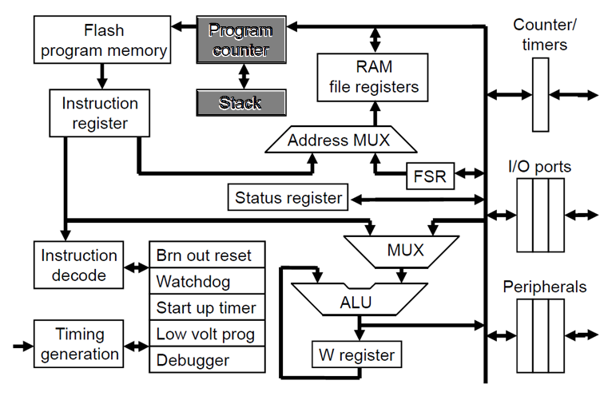
PIC18F: Program flow with stack

Slide 27
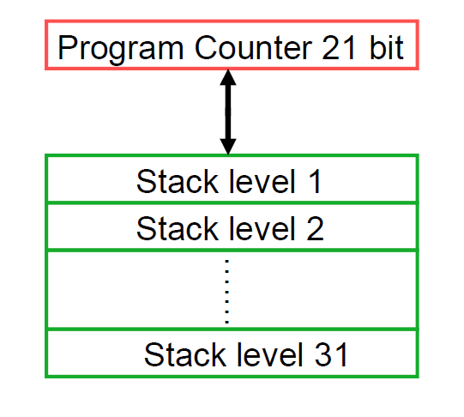
PIC18F: Stack details
Stack organization
Stack usage
Function_1()
Function_2()
Function_3()
“Nested” functions
Limit to nesting!
31 levels

Slide 28
PIC18F: Memories
Separate Memory Regions:
Code / Program – Non-volatile memory (NAND Flash)
Holds program / instructions
Data – Volatile memory (RAM)
Holds run-time data
Address Spaces are different
Though the range “overlaps”
eg. 0x10 could be a code address as well as a data address!
We need to be specific about which memory are we talking about!

Slide 29
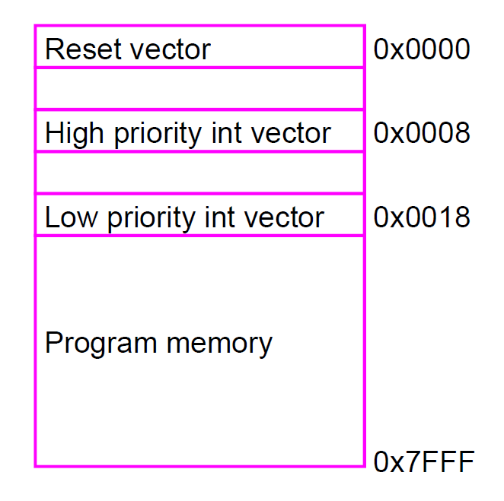
PIC18F: Code memory map
Non-volatile
Range:
0x0000 to 0x7FFF (32k)
Each location contains 1 instruction
3 special addresses:
0x0000
0x0008
0x0018

Slide 30
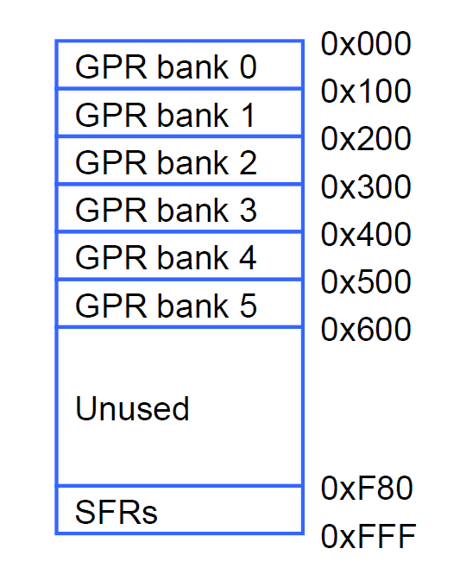
PIC18F: Data memory map
8 bits
Volatile memory
Range:
0x000 to 0xFFF
Each location is 8-bits
Also called FREG
Has an address eg. 0x020
Bank: 256-byte chunk
Top bank: GPR0
Bottom bank: SFR
Only SFR and any 1 GPR active at a time
0x000
0x001

Slide 31
Programming: Why bank data?
Programmers typically use variables for computing
eg. x + y = z
How many variables can the human mind keep track of?
1 Bank is 0x100 – 256 bytes – 256 possible variables
1 bank is more than enough for “our” programming needs
Compilers (higher-level languages like C) need many more variables
Remember: int a, float b, char c[20];
They end up using multiple banks
By using “bank switching”
Most real-world projects are a combination of C and hand-coded (optimized) assembly-code

Slide 32
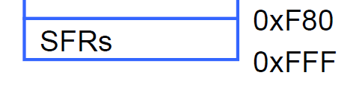
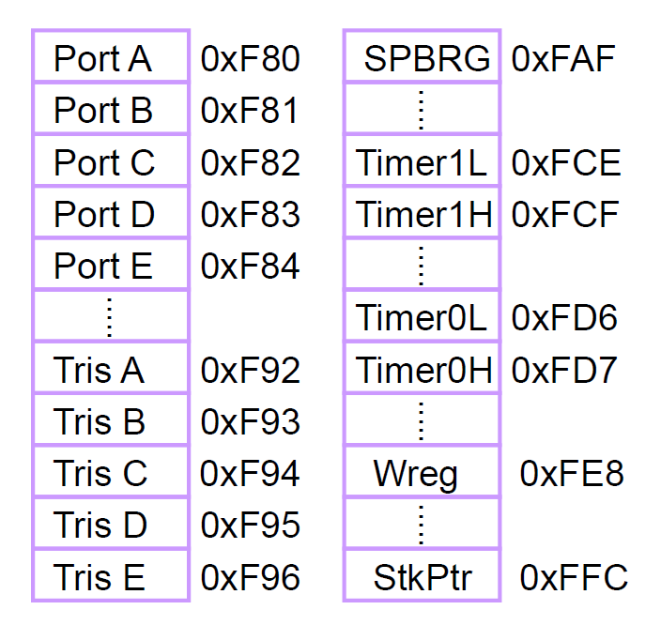
PIC18F: SFR data bank
Special Function Register (SFR) bank
Each location is 8-bits
Also called FREG
Has address as well as “label”/”name”
eg. PORTA, WREG
They fulfill important functions
WREG
Peripherals (IO Ports)
Counters/Timers
Always active data bank

Slide 33
PIC 8-bit family data banking
PIC18F has 6 data banks “populated”
GPR0 to GPR5
Higher addresses are “unused” (bank 6+)
Address exists but no physical memory
Inter-family code portability

Slide 34
Programming: Instruction set
Microcontrollers:
Being computers, only understand binary / digital
Difficult for humans to talk digital
Solution:
Assembly language
Mnemonic based ‘English-like’ language
Called instruction set
eg. ADD A, B ≡ ADD A and B together and give me the result
Every microcontroller has its own instruction set
It’s ‘mother tongue’
An “assembler” converts assembly to binary

Slide 35
PIC 8-bit family: Instruction set
PIC is a RISC chip ≡ less number of instructions
Most instructions execute in:
1 instruction cycle ≡ 4 Clock cycles
Thus:
PIC running at 40 MHz can run 10 M instructions
PIC running at 40 KHz can run ??
Family | # of instructions | Instruction size
PIC16 | 35 | 14 bits
PIC18 | 59 | 16 bits
PIC24 | 71 | 24 bits

Slide 36
PIC18: Assembly
Assembly language instruction format
[label] [mnemonic] [operands] [;comment]
Assembler directives
ORG
EQU/SET
LIST
END
#include
_config
radix

Slide 37
PIC18F: An assembly ‘program’
#include “P18F4520.inc”
MY_VAR EQU 0x01 ; create a label for 0x01
ORG 0x0
ADDLW 0x07
ADDLW MY_VAR ; MY_VAR is 0x01
LABEL1 ADDLW 0x06
GOTO LABEL1 ; loop back!
END

Slide 38
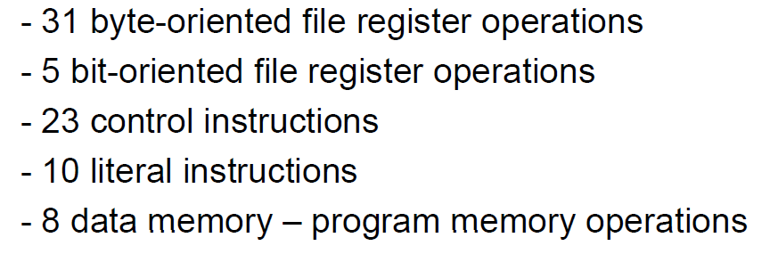
PIC18F: Instruction set grouping

Slide 39
PIC18F: Instruction examples
Byte-oriented file-register operations
MOVWF, ADDWF, CLRF, DECF
Bit-oriented file-register operations
BCF, BTFSC
Control operations
BRA, BNZ, CALL, RETURN
Literal instructions
MOVLW, ADDLW

Slide 40
Thank you!

